Slide 1
Deep Learning
Generated for: LSTM Networks, Deep Learning
Notes:
Welcome to the Deep Learning presentation covering multiple topics. Today we'll explore: LSTM Networks, Deep Learning.

Slide 2
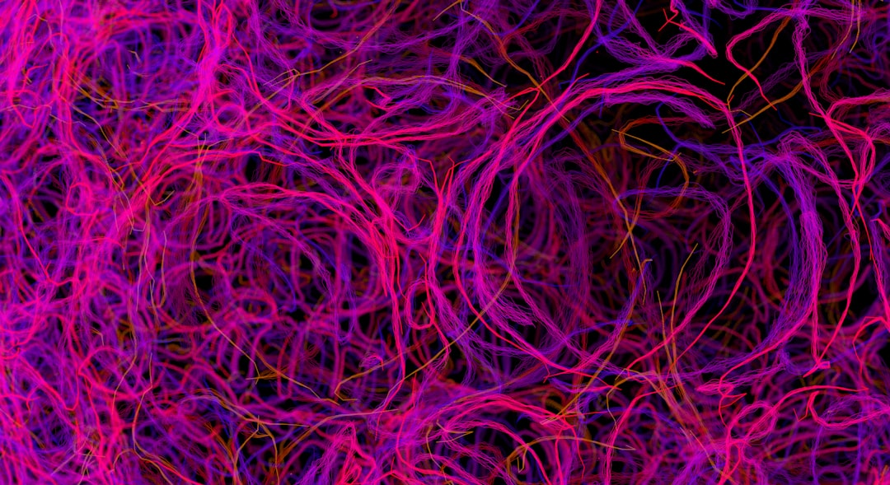
LSTM Networks - Introduction
Long Short-Term Memory networks handle sequential data
Used for time series forecasting and speech recognition
Consist of memory cells and gates for data flow
Gates control information entering and leaving cells
Forget gate decides what to discard from memory
Input gate updates cell state with new information
Output gate generates final output from cell
LSTM networks learn long-term dependencies in data
Effective for tasks with temporal relationships
Key applications in natural language processing
Notes:
When introducing LSTM networks, explain that they are a type of Recurrent Neural Network (RNN) designed to handle sequential data. Provide examples of time series forecasting, such as predicting stock prices or weather, and speech recognition, like voice assistants. Emphasize the role of memory cells and gates in controlling data flow. Ask students to consider how LSTMs can learn long-term dependencies in data, such as in language translation tasks. Key takeaways should include the components of LSTM architecture and their applications in deep learning tasks.

Slide 3
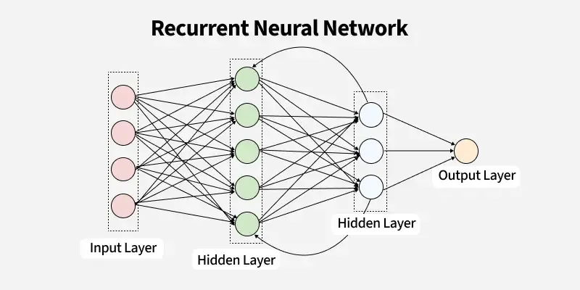
LSTM Networks - Architecture
Long Short-Term Memory networks store data in memory cells
LSTM cells contain gates for input, output, and forget operations
Input gate controls new data entry into cell state
Output gate generates output based on cell state
Forget gate decides what to discard from previous state
Cell state acts as internal memory for sequence data
Hidden state captures short-term dependencies in data
LSTM architecture reduces vanishing gradient problem
Equation: h_t = o_t * tanh(c_t), where h_t is hidden state
LSTM networks learn long-term dependencies in data
Notes:
When explaining the architecture of LSTM networks, emphasize the role of gates in controlling the flow of information into and out of the memory cells. Use examples such as language translation or time series forecasting to illustrate the importance of capturing long-term dependencies. Ask students to consider how the forget gate helps in preventing overfitting by allowing the model to discard irrelevant information. Key takeaways include understanding the components of an LSTM cell and how they contribute to the network's ability to handle sequential data.

Slide 4
LSTM Networks - Architecture
LSTM stands for Long Short-Term Memory network
LSTM is a type of Recurrent Neural Network (RNN)
Designed to handle sequential data and time series
Comprises memory cells and gates for data flow
Input gate controls data entry into memory cell
Output gate generates output from memory cell
Forget gate resets memory cell for new inputs
LSTM equation: σ(x) = 1 / (1 + e^(-x))
LSTM networks learn long-term dependencies in data
Effective for natural language processing tasks
Notes:
When explaining the architecture of LSTM networks, emphasize the role of memory cells and gates. Provide examples of sequential data, such as speech or text, and how LSTMs can learn from these. Discuss the importance of handling long-term dependencies and how LSTMs overcome the vanishing gradient problem. Ask students to consider how LSTMs can be applied to real-world problems, such as language translation or text summarization. Key takeaways include understanding the components of an LSTM network and their functions, as well as the advantages of using LSTMs for sequential data tasks.

Slide 5
Deep Learning - Introduction
Deep learning is a subset of machine learning methods
Inspired by neural networks in the human brain
Uses layered representations of data for analysis
Enables automatic feature extraction and learning
Trained using large datasets and computational power
Can learn complex patterns in data and images
Applications in image recognition and speech processing
Requires significant computational resources and data
Has many variants, including CNNs and RNNs
Used in self-driving cars, medical diagnosis, and more
Notes:
When introducing deep learning, explain that it's a key area of machine learning, inspired by the structure and function of the human brain. Give examples of its applications in image recognition, such as self-driving cars, and speech processing, like virtual assistants. Emphasize the need for large datasets and computational power. Ask students to consider how deep learning might be used in their future careers, and what ethical considerations might arise from its use. Key takeaways should include the definition of deep learning, its relationship to machine learning, and its potential applications and limitations.

Slide 6
Deep Learning - Introduction
Deep learning is a subset of machine learning methods
Inspired by the structure and function of the brain
Uses artificial neural networks to analyze data
Enables computers to learn from experience
Improves performance on complex tasks over time
Requires large amounts of data and computing power
Used in image recognition, speech recognition, and more
Can learn from raw, unprocessed data inputs
Has many applications in industry and research
Notes:
When introducing deep learning, explain that it's a key area of machine learning that's inspired by the brain's structure and function. Provide examples of how deep learning is used in real-world applications, such as self-driving cars and virtual assistants. Ask students to consider the potential benefits and limitations of deep learning, and how it can be applied to solve complex problems. Emphasize the importance of large datasets and computational resources in training deep learning models. Key takeaways include understanding the basics of deep learning, its applications, and the requirements for successful implementation.

Slide 7
Deep Learning - Introduction
Deep learning is a subset of machine learning methods
Inspired by the structure and function of the brain
Uses artificial neural networks to analyze data
Can learn from large amounts of data automatically
Applications in image recognition and natural language
Can be used for predictive modeling and classification
Requires significant computational resources and data
Has many real-world applications and uses
Includes techniques like convolutional and recurrent nets
Notes:
When introducing deep learning, explain that it's a subset of machine learning that's inspired by the brain's structure. Provide examples of its applications, such as image recognition and natural language processing. Emphasize the need for large datasets and computational resources. Ask students to consider potential uses of deep learning in their own fields of interest. Key takeaways include understanding the basics of deep learning and its potential applications.

